Slide 1
ML Experiment Tracking
Pravin Y Pawar
Adapted from
ML Experiment Tracking: What It Is, Why It Matters, and How to Implement It
by Jakub Czakon

Slide 2
a story that have heard too many times
”… So far we have been doing everything manually and sort of ad hoc.
Some people are using it, some people are using that, it’s all over the place.
We don’t have anything standardized.
But we run many projects, the team is growing, and we are scaling pretty fast.
So we run into a lot of problems. How was the model trained? On what data? What parameters we used for different versions? How can we reproduce them?
We just feel the need to control our experiments…”
– unfortunate Data Scientist.

Slide 3
A lot of experiments
And the truth is, when develop ML models, will run a lot of experiments
Those experiments may:
use different models and model hyper parameters
use different training or evaluation data,
run different code (including this small change that you wanted to test quickly)
run the same code in a different environment (not knowing which PyTorch or Tensorflow version was installed)
And as a result, they can produce completely different evaluation metrics.
Keeping track of all that information can very quickly become really hard
Especially
if want to organize and compare those experiments
feel confident that you know which setup produced the best result
This is where ML experiment tracking comes in!

Slide 4
ML experiment tracking
What?
Experiment tracking is the process of saving all experiment related information that you care about for every experiment you run
This “metadata you care about” will strongly depend on your project, but it may include:
Scripts used for running the experiment
Environment configuration files
Versions of the data used for training and evaluation
Parameter configurations
Evaluation metrics
Model weights
Performance visualizations (confusion matrix, ROC curve)
Example predictions on the validation set (common in computer vision)
Of course, you want to have this information available after the experiment has finished,
but ideally, you’d like to see some of it as your experiment is running as well.

Slide 5
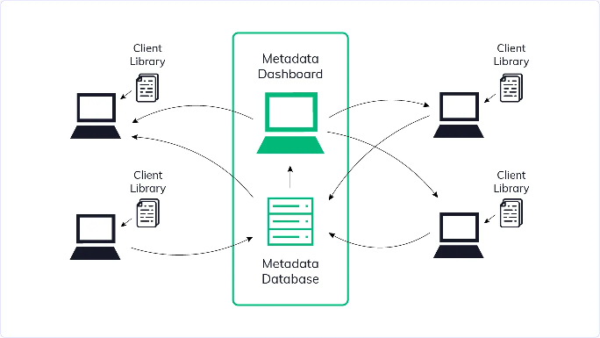
ML experiment tracking
Components
To do experiment tracking properly, need some sort of a system that deals with all this metadata
Typically, such a system will have 3 components:
Experiment database: A place where experiment metadata is stored and can be logged and queried
Experiment dashboard: A visual interface to your experiment database - A place where can see experiment metadata
Client library: Which gives methods for logging and querying data from the experiment database
Of course, you can implement each component in
many different ways, but the general picture will be very similar.

Slide 6
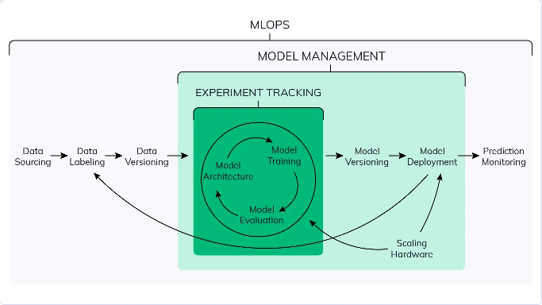
Experiment tracking vs ML model management vs MLOps
isn’t experiment tracking like MLOps or something?
Experiment tracking (also referred to as experiment management) is a part of MLOps:
a larger ecosystem of tools and methodologies that deals with the operationalization of machine learning
MLOps deals with every part of ML project lifecycle
from developing models by scheduling distributed training jobs, managing model serving,
monitoring the quality of models in production, and re-training those models when needed

Slide 7
Experiment tracking vs ML model management vs MLOps(2)
how is experiment tracking different from ML model management?
Experiment tracking focuses on the iterative model development phase
when you try many things to get your model performance to the level you need
ML model management starts when models go to production:
streamlines moving models from experimentation to production
helps with model versioning
organizes model artifacts in an ML model registry
helps with testing various model versions in the production environment
enables rolling back to an old model version if the new one seems to be going crazy
But not every model gets deployed.
Experiment tracking is useful even if your models don’t make it to production (yet).
And in many projects, especially those that are research-focused, they may never actually get there
But having all the metadata about every experiment you run ensures that you will be ready when this magical moment happens.

Slide 8
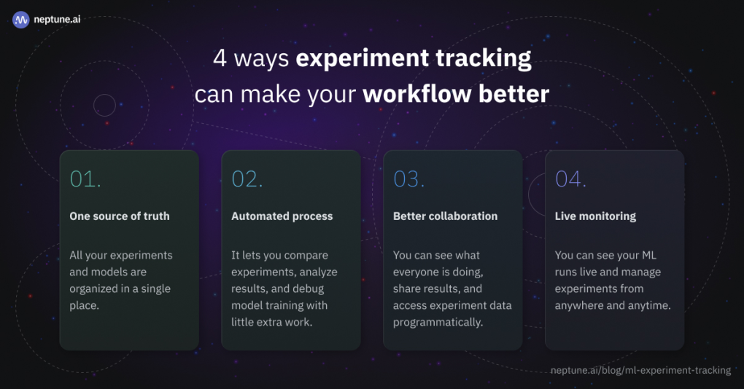
Why does experiment tracking matter?
4 ways in which experiment tracking can actually improve ML workflow

Slide 9
All ML experiments are organized in a single place
There are many ways to run ML experiments or model training jobs:
Private laptop
PC at work
A dedicated instance in the Cloud
University cluster
Kaggle kernel or Google Colab
And many more.
Sometimes just want to test something quickly and run an experiment in a notebook
Sometimes want to spin up a distributed hyper parameter tuning job
Either way, during the course of a project (especially when there are more people working on it),
can end up having your experiment results scattered across many machines

Slide 10
ML experiments are organized in a single place(2)
With the experiment tracking system, all of experiment results are logged to one experiment repository by design
keeping all of experiment metadata in a single place, regardless of where its run, makes experimentation process so
much easier to manage
Specifically, a centralized experiment repository makes it easy to:
Search and filter experiments to find the information you need quickly
Compare their metrics and parameters with no additional work
Drill down and see what exactly it was that you tried (code, data versions, architectures)
Reproduce or re-run experiments when you need to
Access experiment metadata even if you don’t have access to the server where you ran them
Additionally, can sleep peacefully knowing that all the ideas tried are safely stored, and can always go back to them later

Slide 11
Compare experiments, analyze results, debug model training with little extra work
Whether debugging training runs, looking for improvement ideas, or auditing current best
models, comparing experiments is important
But when don’t have any experiment tracking system in place:
the way you log things can change,
you may forget to log something important
you may simply lose some information accidentally
In those situations, something as simple as comparing and analyzing experiments can get difficult or
even impossible
With an experiment tracking system, experiments are stored in a single place,
follow the same protocol for logging them, so those comparisons can go really deep

Slide 12
Benefits of tracking
Proper experiment tracking makes it easy to:
Compare parameters and metrics
Overlay learning curves
Group and compare experiments based on data versions or parameter values
Compare Confusion Matrices, ROC curves, or other performance charts
Compare best/worst predictions on test or validation sets
View code diffs (and/or notebook diffs)
Look at hardware consumption during training runs for various models
Look at prediction explanations like Feature Importance, SHAP or Lime
Compare rich-format artifacts like video or audio
… Compare anything else you logged
Modern experiment tracking tools will give many of those comparison features (almost) for free
Some tools even go as far as to automatically find diffs between experiments or show which parameters have the biggest
impact on model performance
When have all the pieces in one place, might be able to find new insights and ideas
just by looking at all the metadata logged
especially true when you are not working alone!

Slide 13
What should be tracked in any ML experiment?
Things that should be keep track of regardless of the project are:
Code:
preprocessing, training and evaluation scripts, notebooks used for designing features, other utilities.
All the code that is needed to run (and re-run) the experiment
Environment:
The easiest way to keep track of the environment is to save the environment configuration files like `Dockerfile` (Docker), `requirements.txt` (pip) or `conda.yml` (conda)
Can also save the Docker image on Docker Hub, but I find saving configuration files easier
Data:
saving data versions (as a hash or locations to data files) makes it easy to see what your model was trained on
can also use modern data versioning tools like DVC (and save the .dvc files to your experiment tracking tool)
Parameters:
saving your run configuration is absolutely crucial
Metrics:
logging evaluation metrics on train, validation, and test sets for every run is pretty obvious
Keeping track of those things will let you reproduce experiments, do basic debugging, and understand what happened at a high-level.
That said, can always log more things to gain even more insights.

Slide 14
How to set up experiment tracking?
There are (at least) a few options. The most popular being:
Spreadsheets + naming conventions
Versioning configuration files with Github
Using modern experiment tracking tools

Slide 15
Spreadsheets + naming conventions
(but please don’t use it)
A common approach
Simply create a big spreadsheet to put all of the information (metrics, parameters, etc) and a directory structure
where things are named in a certain way
names usually end up being really long like ‘model_v1_lr01_ batchsize64_ no_preprocessing_ result_accuracy082.h5’
Whenever an experiment is run, look at the results and copy them to the spreadsheet
In some situations, it can be just enough to solve experiment tracking problems
may not be the best solution but it is quick and simple
…things can fall apart really quickly!

Slide 16
Spreadsheets + naming conventions(2)
(but please don’t use it)
A few major reasons why tracking experiments in spreadsheets doesn’t work for many people:
have to remember to track them
If something doesn’t happen automatically, things get messy, especially with more people involved
have to be sure that you or your team will not overwrite things in the spreadsheet by accident
Spreadsheets are not easy to version, so if this happens, you are in trouble
have to remember to use the naming conventions
If someone on your team messes this up, you may not know where the experiment artifacts (model weights, performance charts) for the experiments you ran are.
have to back up your artifact directories (remember that things break)
When your spreadsheet grows, it becomes less and less usable
Searching for things and comparing hundreds of experiments in a spreadsheet (especially if you have multiple people
that want to use it at the same time) is not a great experience.

Slide 17
Versioning configuration files with Github
Can version metadata files in GitHub
Another option is to version all of experiment metadata in Github
to commit metrics, parameters, charts, and whatever want to keep track of to Github when running experiment
can be done with post-commit hooks where you create or update some files (configs, charts, etc) automatically after
experiment finishes
… Github wasn’t built for … machine learning
It can work in some setups but:
.git and Github wasn’t built for comparing machine learning objects
Comparing more than two experiments is not going to work. Compare in .git systems was designed for comparing two branches, master and develop, for example. If you want to compare multiple experiments, take a look at metrics and overlay learning curves you are out of luck.
Organizing many experiments is difficult (if not impossible). You can have branches with ideas or a branch per
experiment but the more experiments you run the less usable it becomes
You will not be able to monitor your experiments live, the information will be saved after your experiment is finished.

Slide 18
Using modern experiment tracking tools
While can try and adjust general tools to work for machine learning experiments,
could just use one of the solutions built specifically for tracking, organizing, and comparing experiments
Experiment is logged to a central experiment database and displayed in the experiment dashboard,
where it can be searched, compared, and drill down to whatever information needed
Today there are at least a few good tools for experiment tracking!
Designed to treat machine learning experiments as first-class citizens, and they will always:
be easier to use for a machine learning person than general tools
have better integrations with the ML ecosystem
have more experiment-focused features than the general solutions

Slide 19
Thank You!
In our next session:

